Slide 1
NETFLIX MOVIES AND TV SHOWS ANALYSIS
Group 1

Slide 2
summary
One of the problems for our dataset is limited data for the year 2020.

Slide 3
objective and description of the project
Objective – Generate insights on Netflix content.
How – By processing the dataset which is sourced from Kaggle.com and using various data exploration techniques.
Project tasks-
Project Proposal – Link
Data source- Kaggle.com
Data cleaning and Exploration -
Data Visualization
Data insights
GitHub Management
Conclusion

Slide 4
Data Cleaning and exploration
Data challenges and limitations
Data available is from content added between 2008 and 2020.
Partial data available for 2020.
Missing data attributes like IMDB ratings.
Data cleaning :
Reviewed data frame statistics periodically to identify data issues.
Column with null values is removed to make data more presentable and readable.
Formats have been changed for columns ‘duration’ and ‘date added’.
Removed spaces via strip function few columns.
Enhanced data by extracting IMDB ratings from OMDB API. Limited by 1000 api calls per day
Data exploration:
We have used Matplotlib and Seaborn to create pie charts and plots.

Slide 5
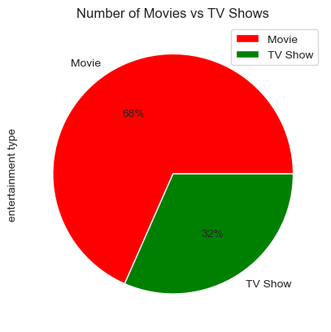
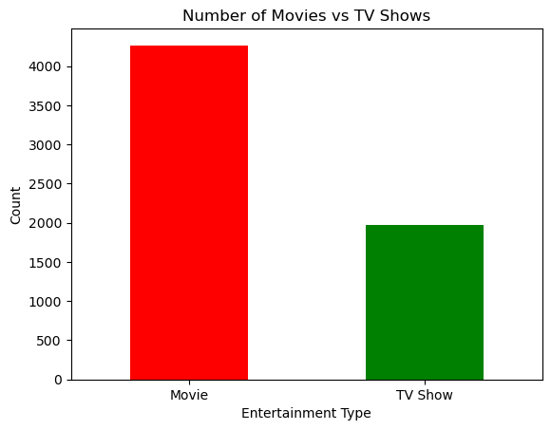
WHAT TYPE OF CONTENT IS AVAILABLE ON NETFLIX 68% of the content on Netflix is movies
There are more movie titles than tv show BY THE START OF 2020

Slide 6
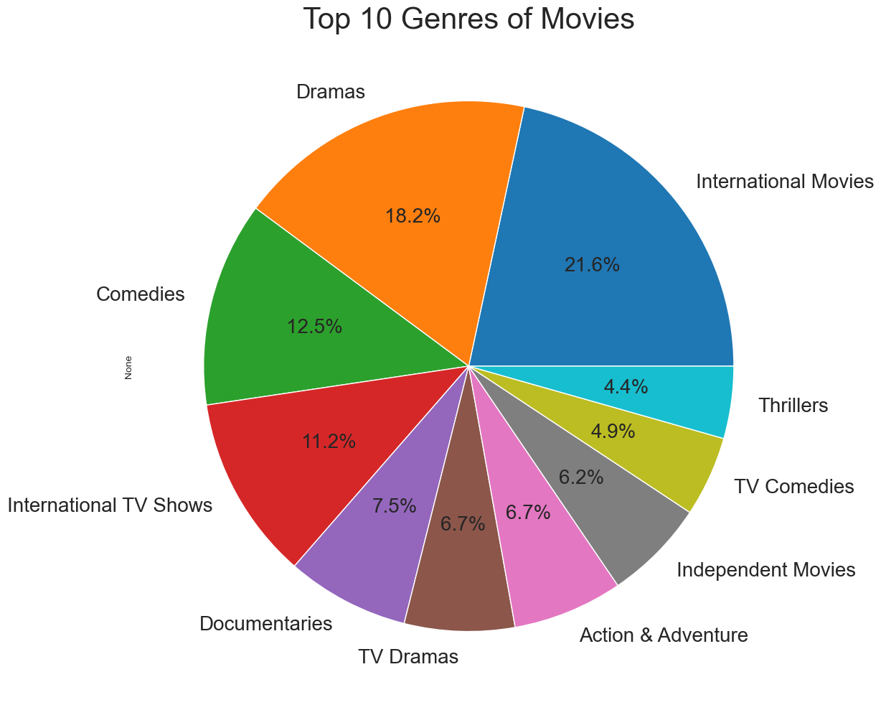
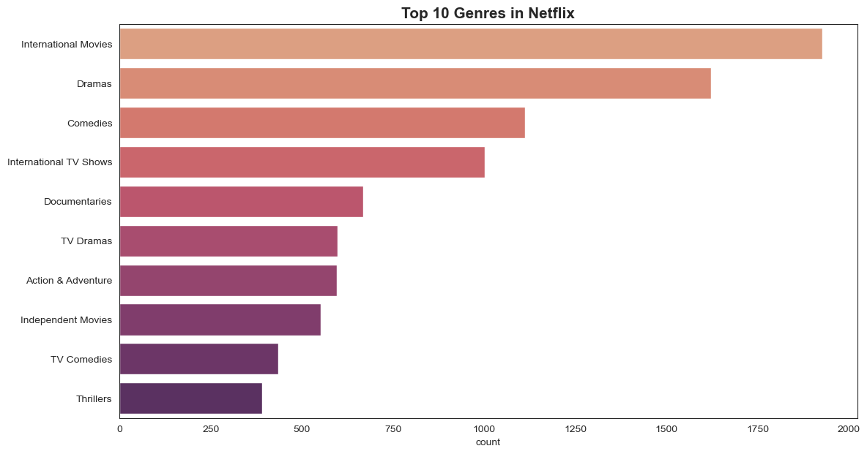
WHAT ARE THE MOST POPULAR GENRE ON NETFLIX

Slide 7
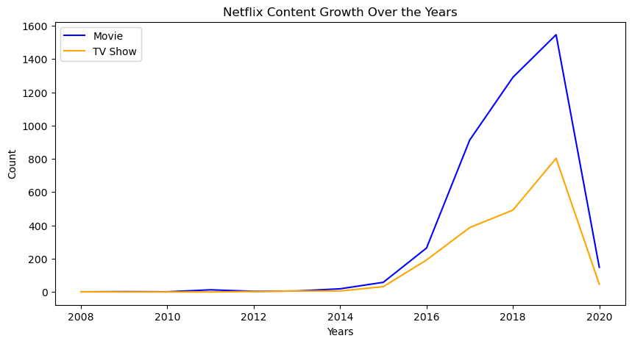
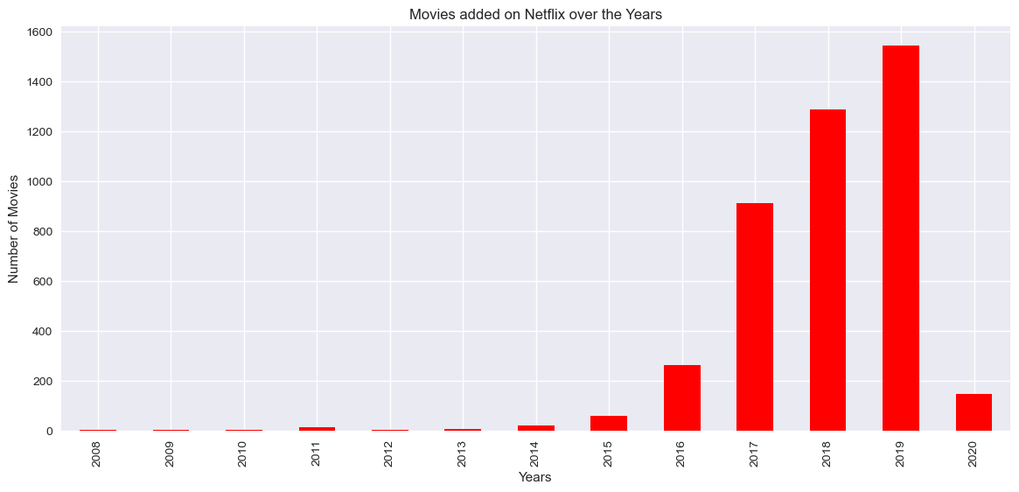
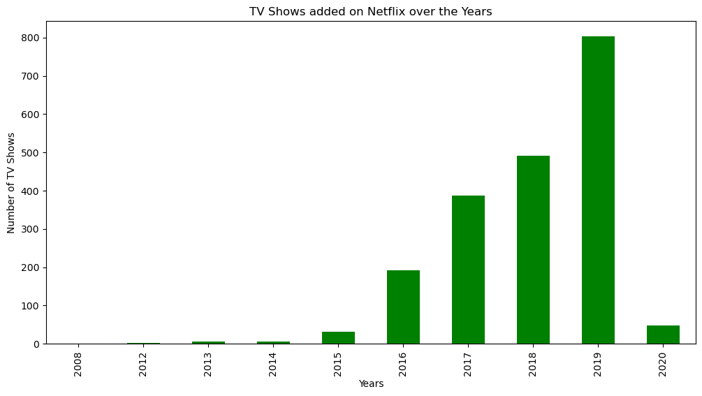
How has Netflix content grown over the years? There has been a steady growth of content on Netflix. However % the age increase for tv shows is more than for movies which could indicate netflix’s strategy to keep the audience engaged in longer-running content

Slide 8
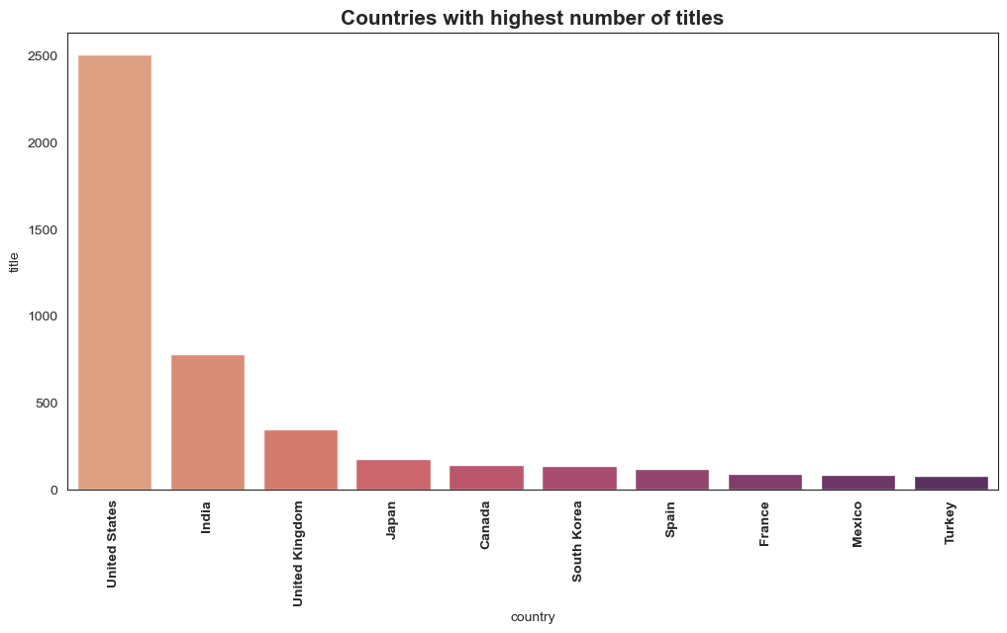
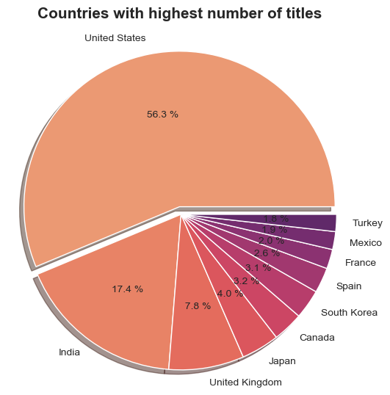
Which country has the highest number of titles on Netflix? 56% of the titles are available in the United States followed by India and UK.

Slide 9
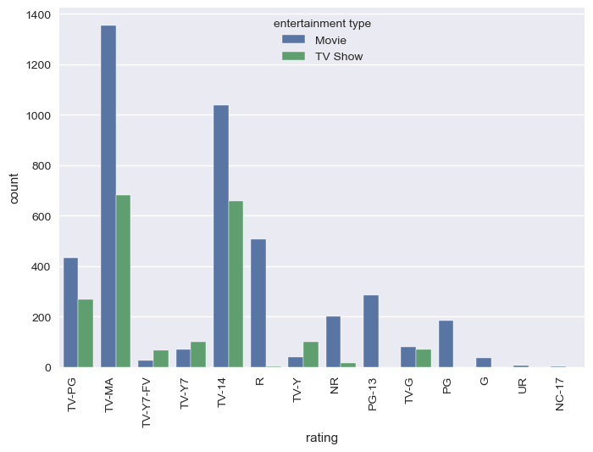
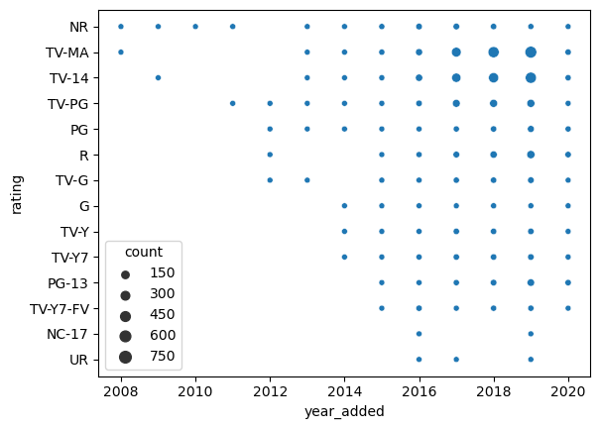
What are the most popular maturity rating on Netflix? Most of the movies available on Netflix are for a mature audience. The maximum number of titles is for Movies with tv ma ratings

Slide 10
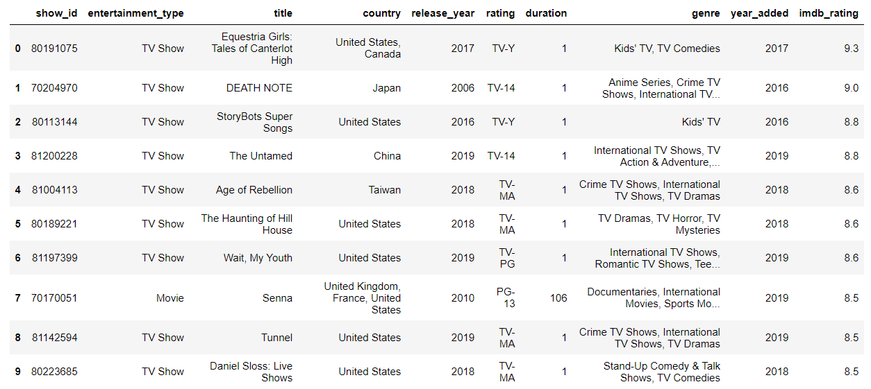
Top 10 highest rated titles based on imdb rating

Slide 11
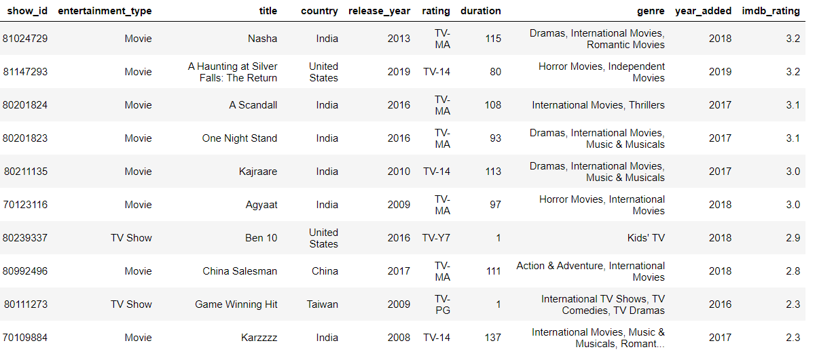
Lowest 10 rated titles based on imdb rating

Slide 12
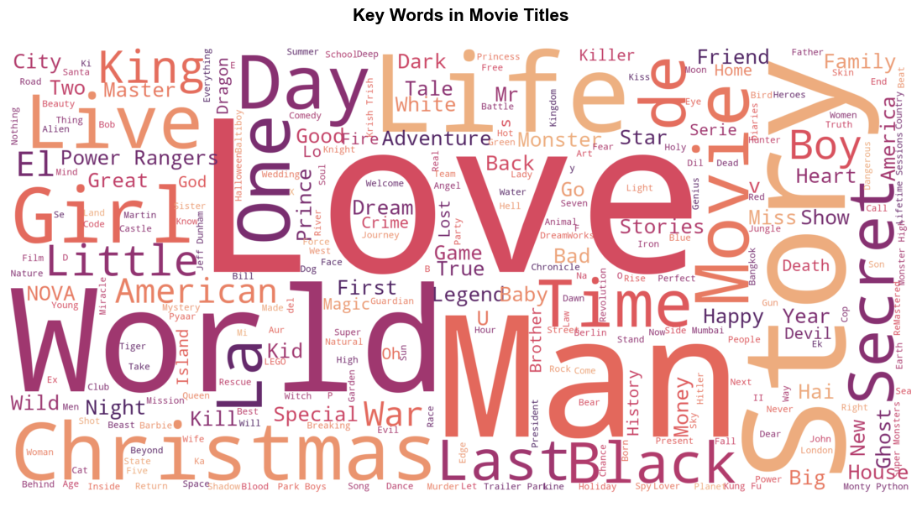
FIN

